Slide 1


ISQA 8150 Research Project
By Joshua Ellis, Alex Daly, and Satwik Chandra

Slide 2
Agenda
Data Explanation
Descriptive Analysis
Research Question 1 Analysis Method and Findings
Research Question 2 Analysis Method and Findings
Conclusions

Slide 3
Omaha Girls Rock Data

Slide 4
Descriptive Analysis

Slide 5
Are There Significant Differences in Answer Ratings for Various Outcomes Between the Younger Group and the Older Group?
We are interested in comparing pretest and posttest results (delta scores) according to the age group of the participants. We would like to know which questions (if any) improved significantly between young and old group participants after the OGR program. Since we are aiming for positive improvements with $\mu_d > 0$, we performed a right-tailed (matched-samples) t-test at the 5% significance level. Since we are performing a right-tailed test, the alternative hypothesis takes the greater condition and the null hypothesis takes the condition below.
$H_0: \mu_d \le 0$
$H_a: \mu_d > 0$

Slide 6
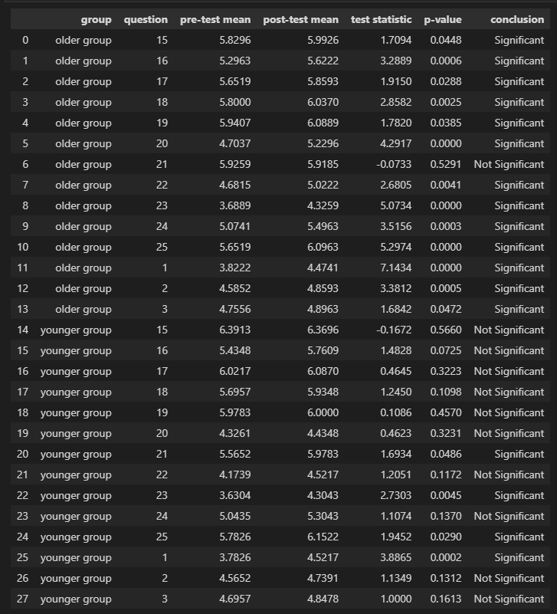
Result
The table consists of group, question, pre-test mean, post-test mean, test statistic, p-value, and conclusion. All p-values ​​are less than or equal to 0. 05, except question 21 in older groups. While in younger age groups, questions 1,21,23,25 is significant i.e., p-value for those is less than or equal to 0.05.

Slide 7
Conclusion:
In terms of the older group there is an almost all the questions where there is a significant difference between pre-test and post-test mean.
In the younger group, there is not much difference between the pre-test and post-test except for a few questions.
Hence the null hypothesis is accepted but not completely.

Slide 8
Does the Race/Ethnicity of Participants Influence the Change in Scores for Various Questions Over Time?
One-Way Anova and Fisher’s LSD
Hypotheses
Null
Alt

Slide 9
Conclusions

